Slide 1


Department of ECE
College of Engineering Guindy, Anna University, Chennai
EC23702 – Mini Project
Second Review
25.09.2026
Lightweight AUTOSAR-Inspired Layered Firmware Architecture for Distributed Embedded Systems
Under the Guidance of:
Dr K Praveen
Assistant Professor (SI. Gr.)
Department of ECE
CEG Campus, Anna University
Project Members:
Pragadeesh R - 2023105512
Jagakishan S K - 2023105513
Hariharan S - 2023105528

Slide 2

Introduction
Modern automotive embedded systems consist of multiple Electronic Control Units (ECUs) communicating over standardized communication protocols.
Traditional embedded firmware tightly couples application logic with hardware drivers, making software difficult to reuse, maintain, and scale.
Industrial solutions like AUTOSAR, IMA overcome these issues using layered software architecture, runtime communication, hardware abstraction, and reusable software components.
There is a lack of open-source architecture for small and medium scale implementation of distributed embedded systems.
Our project develops a lightweight AUTOSAR-inspired firmware framework using ARM controllers and open-source RTOS, recreating essential AUTOSAR concepts including layered architecture, driver abstraction, runtime communication, and distributed ECU communication.

Slide 3
Literature Review
Paper | Methodology | Inference
Design and Implementation Procedure for an Advanced Driver Assistance System Based on an Open Source AUTOSAR (Jaeho Park & Byoung Wook Choi, Electronics, 2019) | Developed an ADAS application using Open Source AUTOSAR by dividing the system into Application Software Components (SWC), Runtime Environment (RTE), and Basic Software (BSW). Implemented CAN communication stack and evaluated task scheduling, latency, and communication performance. | Demonstrated that a layered AUTOSAR architecture improves software modularity, portability, and maintainability while enabling efficient ECU communication.
Hardware Prototyping using FreeRTOS while Developing AUTOSAR Compliant Application Software using Simulink (Roopak Ingole & Benjamin Eckhart, 2022) | Integrated FreeRTOS with Simulink-generated AUTOSAR applications using lightweight middleware and manually implemented RTE functions for rapid hardware prototyping. | Showed that FreeRTOS-based lightweight prototyping significantly reduces development time and cost while supporting AUTOSAR-compliant application development.
Component-Based Middleware Synthesis for AUTOSAR Systems (Dietmar Schreiner, Markus Schordan, Karl M. Goschka, 2009) | Proposed a component-based middleware framework that automatically synthesizes communication middleware between AUTOSAR software components. Focused on software component interaction, middleware generation, and runtime communication.. | Demonstrated that middleware abstraction simplifies software integration, improves component reusability, and reduces coupling between applications and hardware platforms.

Slide 4
Problem Statement
Embedded applications are frequently designed with monolithic architecture, where application logic, peripheral drivers, communication mechanisms, and system services are tightly coupled.
Although industrial frameworks such as AUTOSAR address these challenges through standardized layered software architecture, their complexity, licensing requirements, and extensive tooling make them impractical for academic learning and experimentation.
Though Open AUTOSAR provides an open-source alternative, internal layers like BSW layer, Physical layer are non-configurable, and provide all services regardless of the individual ECUs.
Existing solutions are application based and utilise IDE dependent platforms to overcome the limitation.

Slide 5
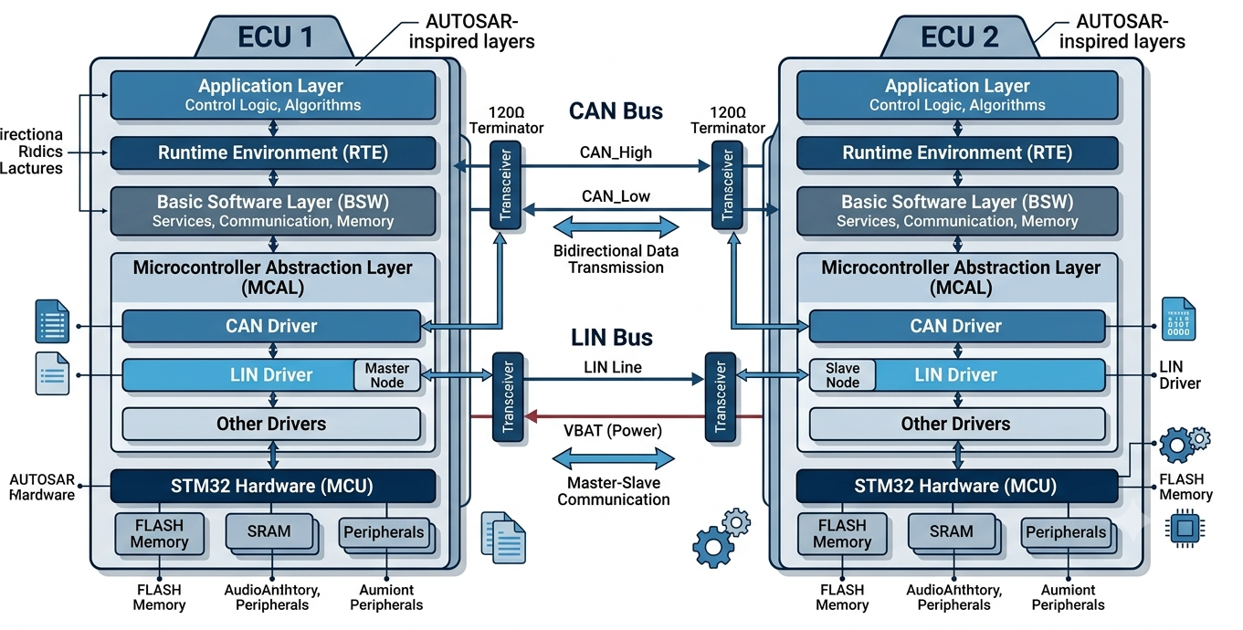

Objectives
Develop lightweight AUTOSAR-inspired layered firmware.
Develop scalable and reusable physical layer.
Integrate FreeRTOS scheduler in BSW Layer.
Validate real-time task execution and synchronize co-working of multiple ECUs.
Compare modular architecture with traditional firmware.

Slide 6
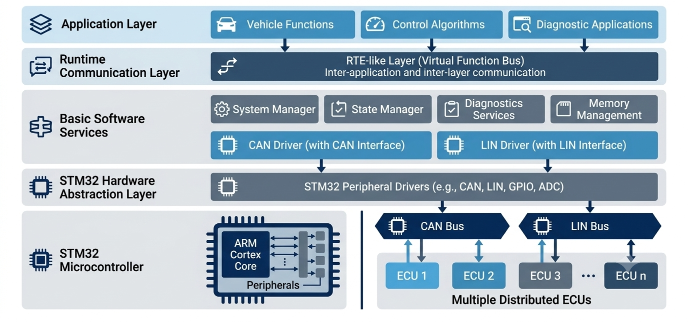
Proposed Methodology

Slide 7
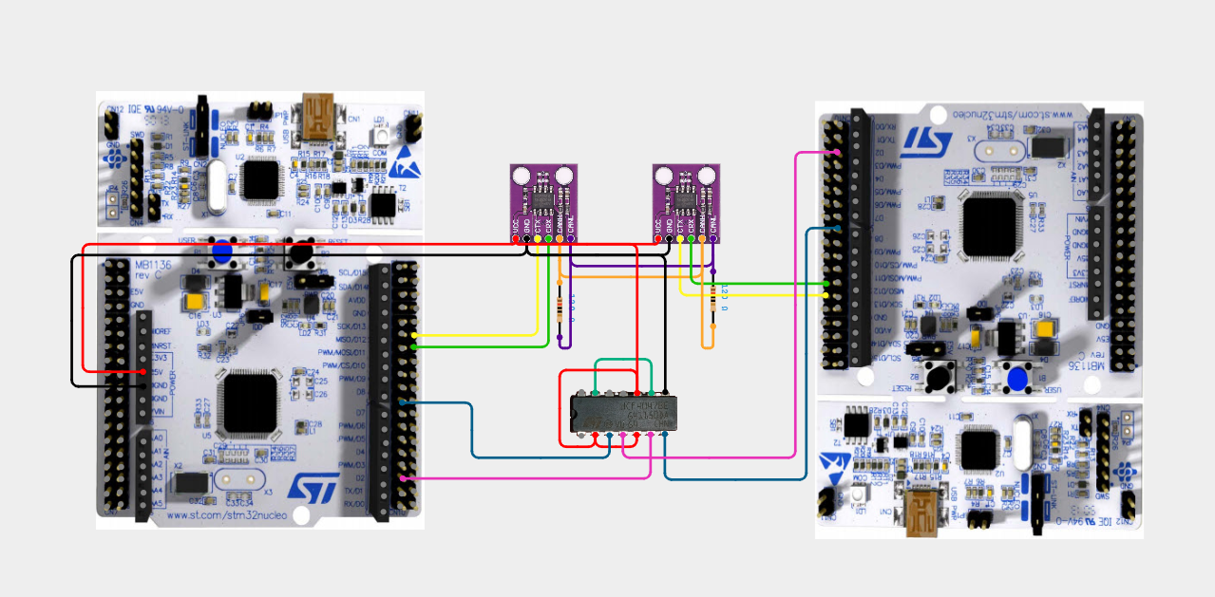
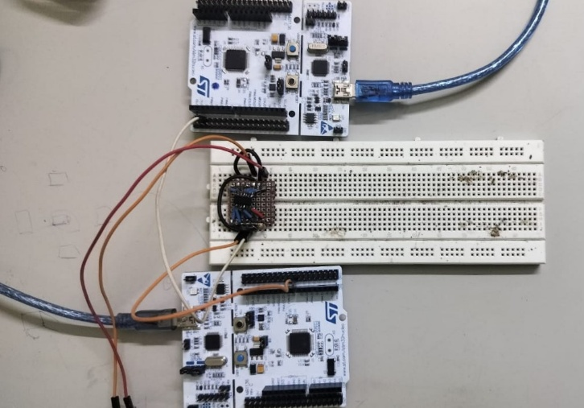
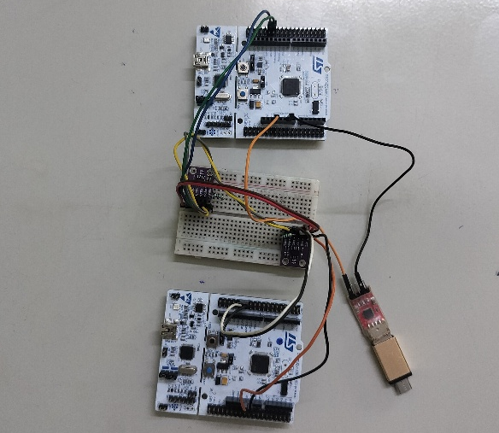
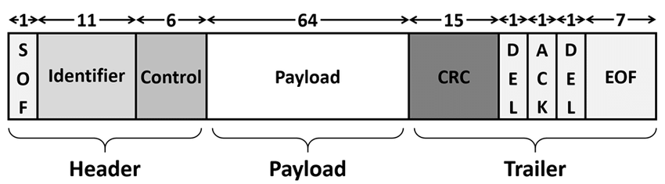
Results
Current Progress & Results
STM32 development environment configured.
Physical Layer successfully developed.
CAN Driver implemented using bare-metal programming.
LIN Driver implemented using bare-metal programming.
Successful CAN frame transmission and reception.
Successful LIN frame transmission and reception.
Driver APIs modularized for portability.
Circuit Connection
CAN Driver Validation
Hardware Setup
Parameter | Observed Value
Transmitted Frames | 107,000
Transmitted Data | 856000 B
Received Packets | 106,992
Received Bytes | 855936 B
Arbitration Lost | 3
Transmission Errors | 8
Reception Errors | 8
Minimum Latency | 537 cycles / 33.56 µs
Average Latency | 537 cycles / 33.56 µs
Maximum Latency | 578 cycles / 36.06 µs

Slide 8
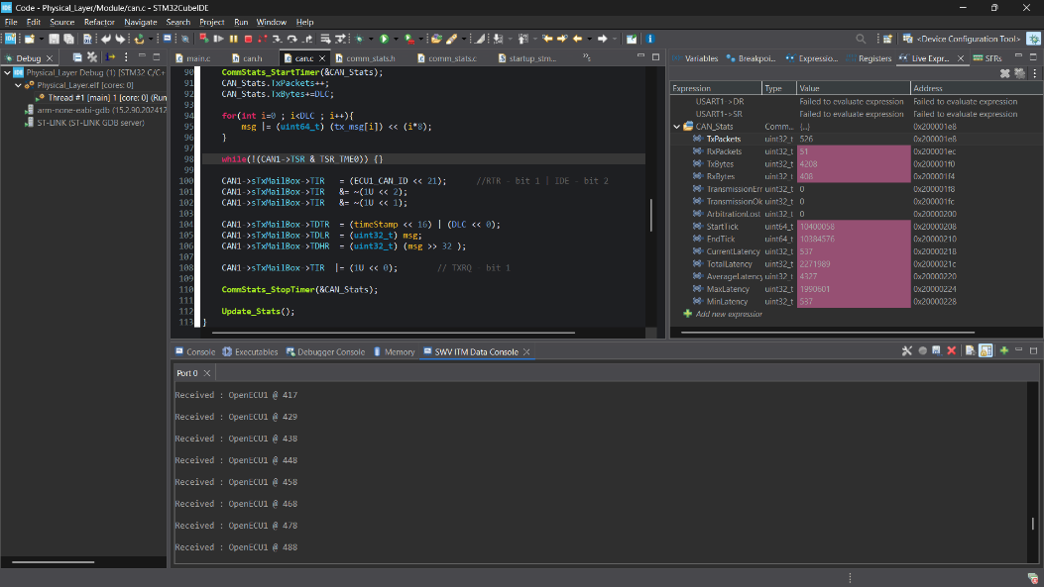
Results
Physical Layer Validation over CAN interface

Slide 9
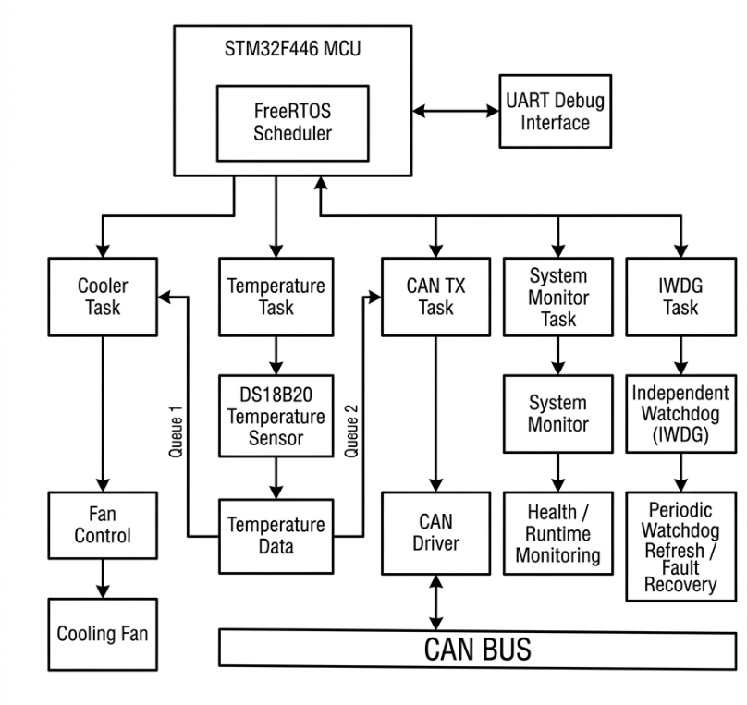
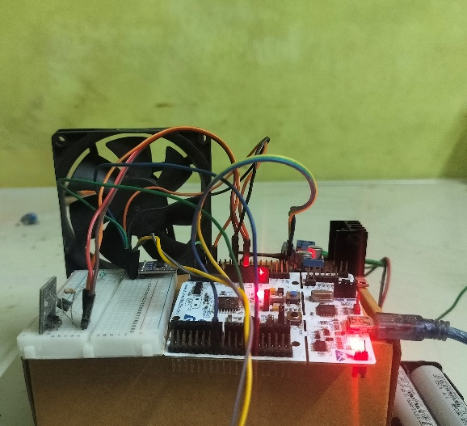
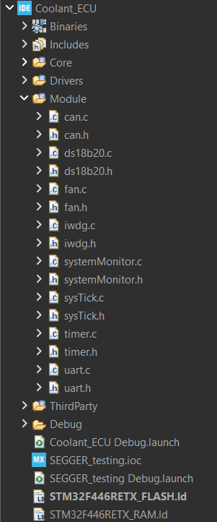
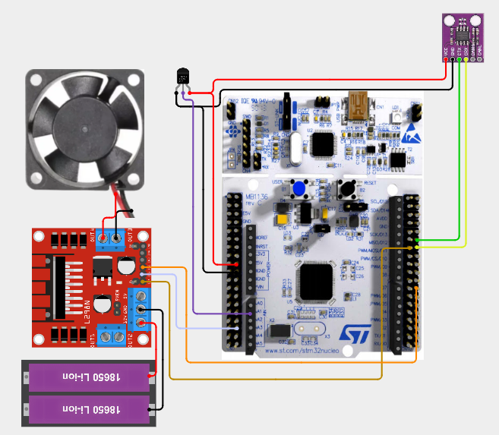
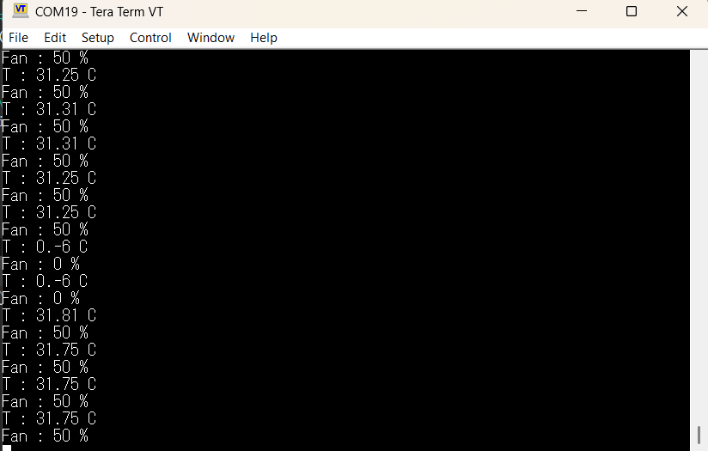

ECU1 – Coolant System
Hardware Setup
File Structure
Block Diagram
Circuit Connection
Temperature Control

Slide 10
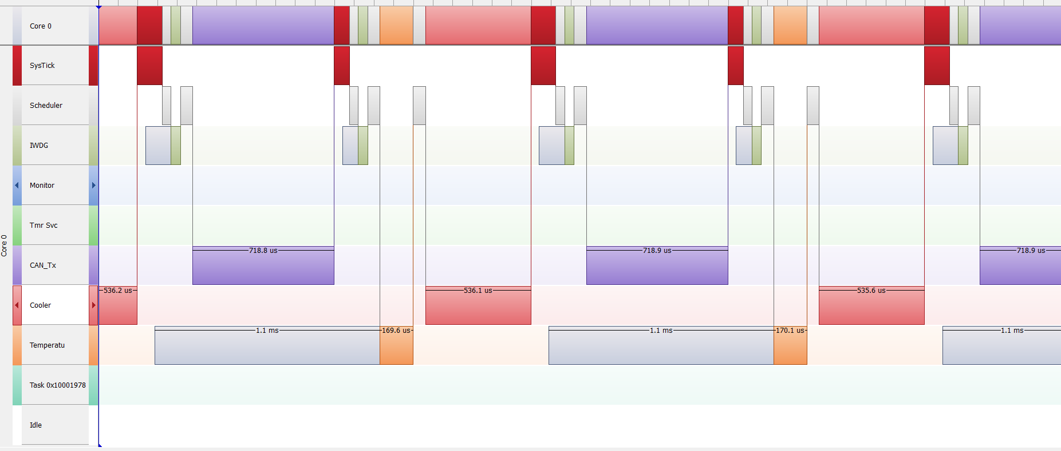
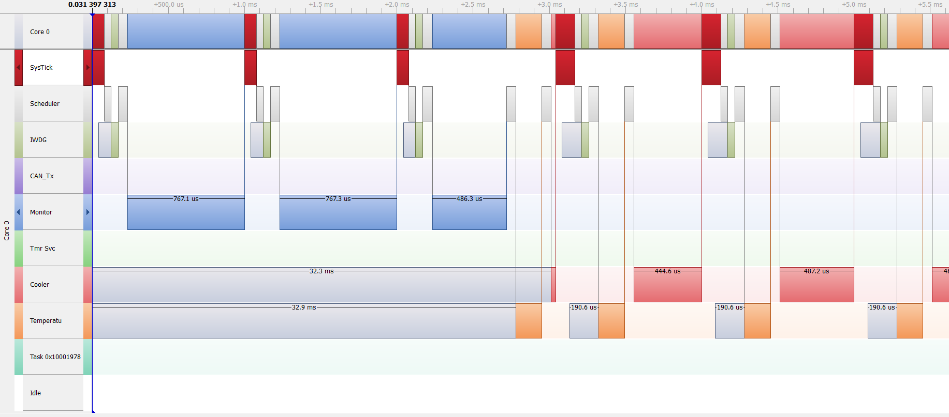
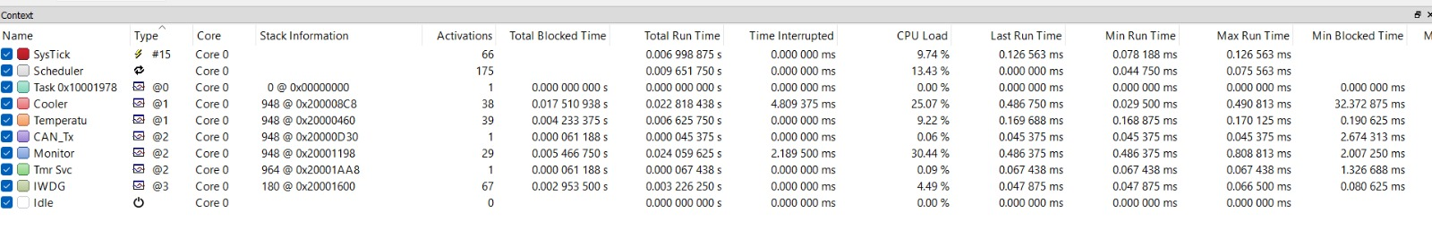
RTOS Scheduling
With CAN task
With Monitor task

Slide 11
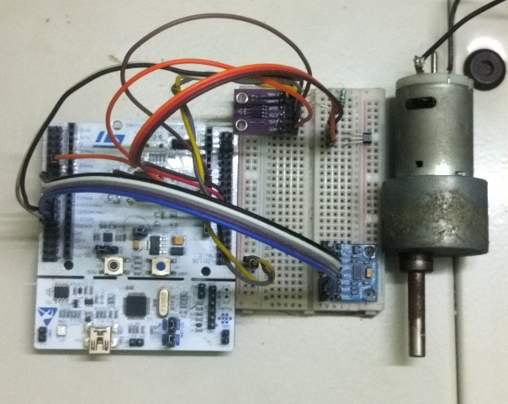
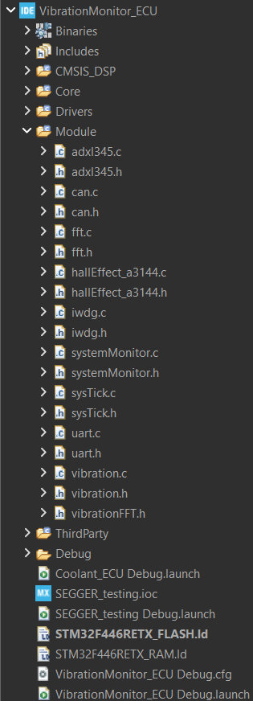

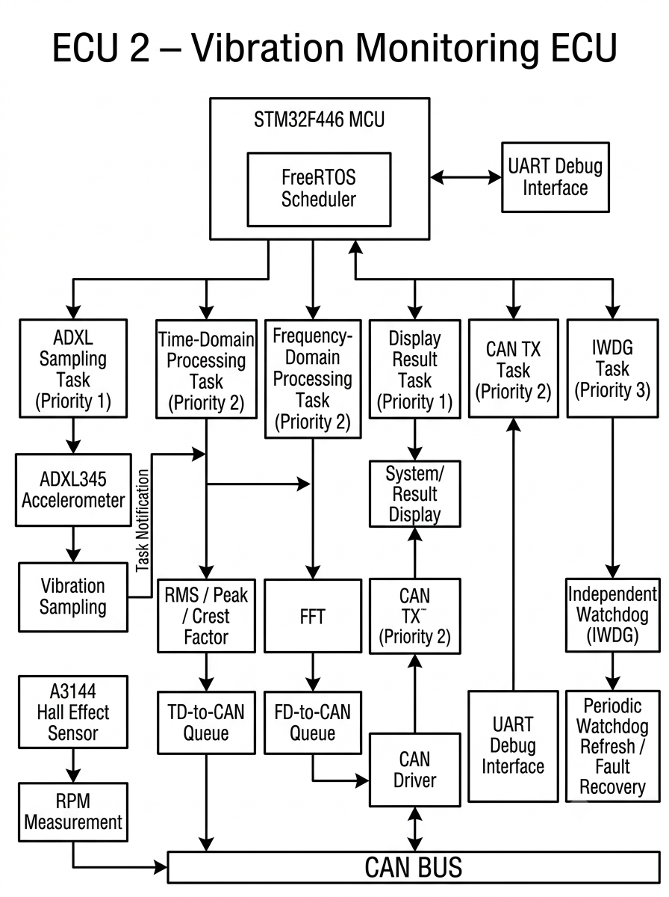
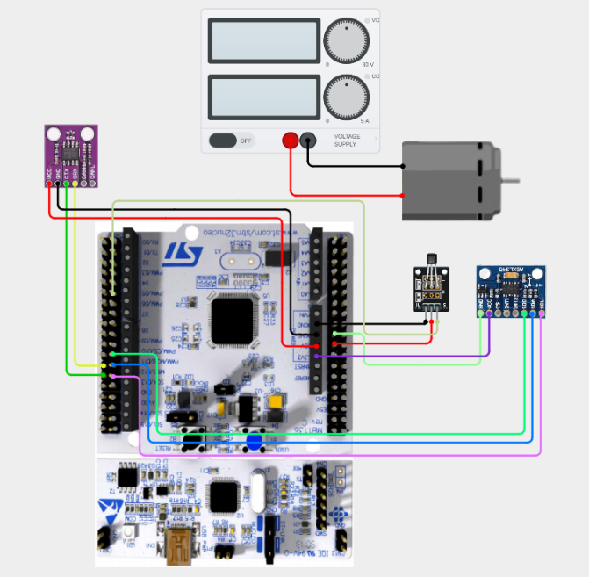

ECU2 –Vibration Monitor System
Hardware Setup
File Structure
Block Diagram
Circuit Connection

Slide 12
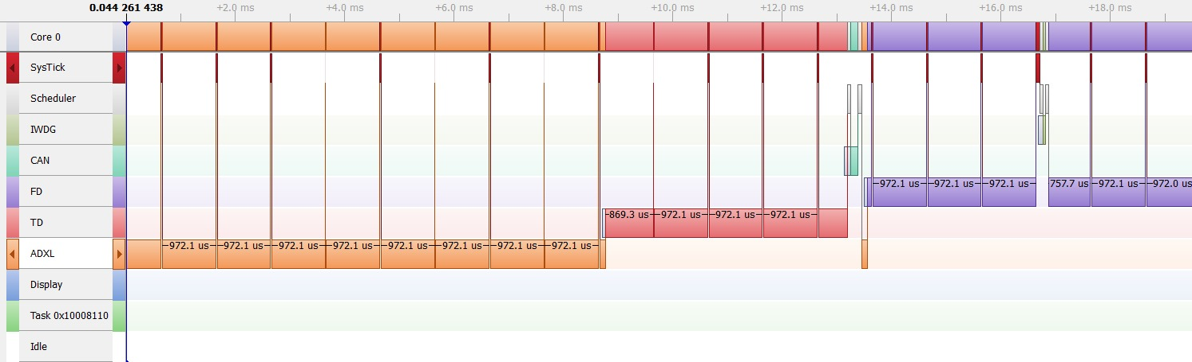
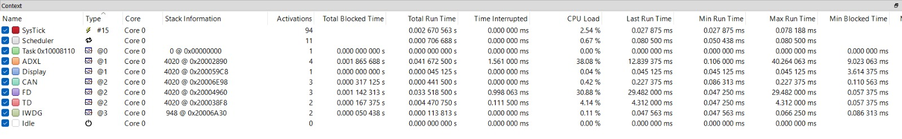
ECU2 –Vibration Monitor System
RTOS Scheduling

Slide 13
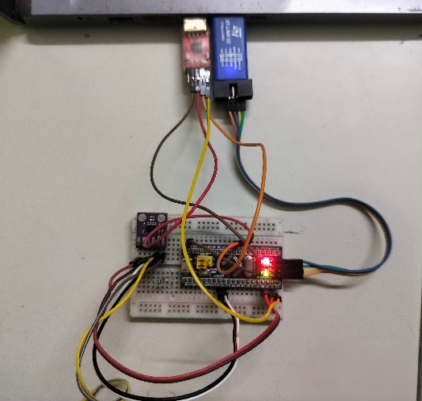
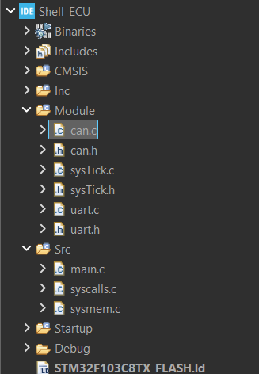
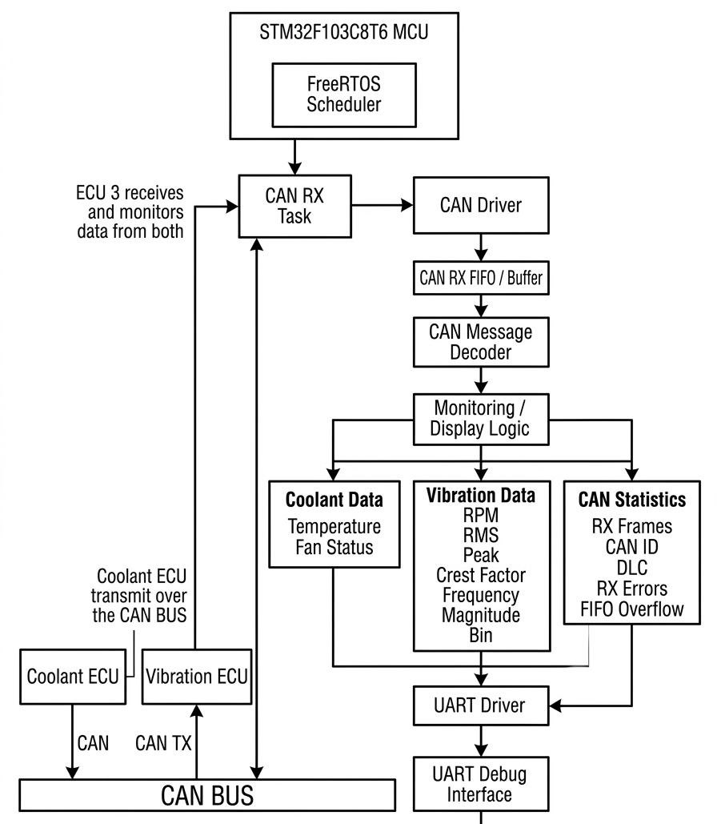
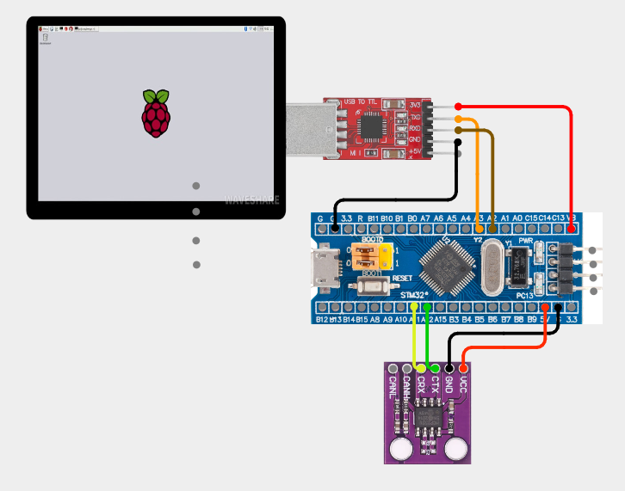

ECU3 – System Monitor
Hardware Setup
File Structure
Block Diagram
Circuit Connection

Slide 14
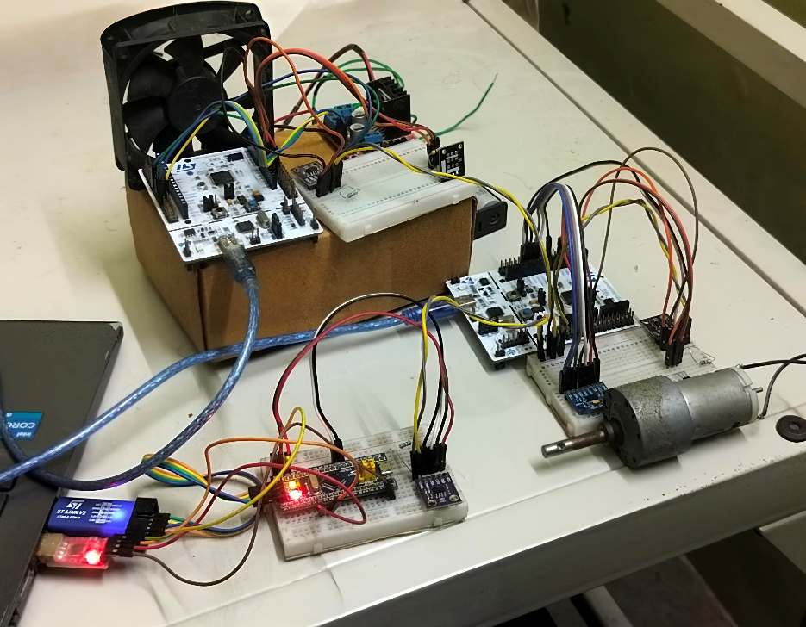
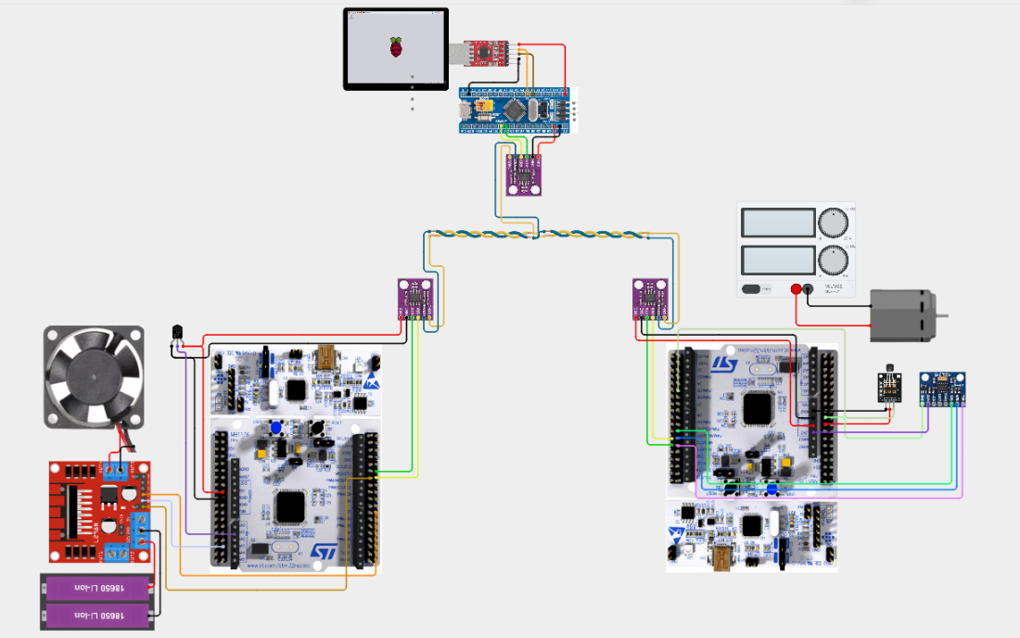
RTOS Scheduling
Overall System
ECU3
ECU2
ECU1
The implemented architecture successfully separates hardware drivers, communication, RTOS scheduling and application services, allowing multiple ECU applications to operate over a common embedded platform. Quantitative testing of CAN communication, task execution, CPU/RAM utilization, sensor acquisition and fault recovery is used to evaluate real-time performance and scalability.

Slide 15
References
J. Park and B. W. Choi, “Design and Implementation Procedure for an Advanced Driver Assistance System Based on an Open Source AUTOSAR,” Electronics, vol. 8, no. 9, Art. no. 1025, 2019.
R. Ingole and B. Eckhart, “Hardware Prototyping using FreeRTOS while Developing AUTOSAR Compliant Application Software using Simulink™,” Journal of Technological Innovations, vol. 3, no. 1, 2022.
M. Becker et al., “Synthesizing Communication Middleware for Component-Based AUTOSAR Systems,” in Proc. IEEE 16th International Conference on Emerging Technologies and Factory Automation (ETFA), 2011.
M. Di Natale, H. Zeng, P. Giusto, and A. Ghosal, “Understanding and Using the Controller Area Network Communication Protocol”, Springer, 2012.

